Slide 1

SMART ATTENDANCE MONITORING SYSTEM BASED ON FACIAL RECOGNITION
PROJECT MADE BY
THORAT AMEY ARUN
23MCS1004
GUIDE NAME
Dr. BHARATHI RAJA S

Slide 2
Table Of Contents
Abstract
Introduction
Objectives
Algorithms
Dataset
Proposed System
Results
Conclusion

Slide 3
Abstract
Face recognition technology is used in smart attendance monitoring systems to automatically identify and confirm people so that their attendance can be monitored.
Students or employees can just stroll in front of a camera to have their attendance recorded without having to carry any specific cards or gadgets.
This presentation's major goal is to provide insight into an algorithm, dataset, proposed system, and result of the project.

Slide 4
Introduction
Face recognition, often abbreviated as FR, is a cutting edge technology that has revolutionized the way we identify and authenticate individuals.
It harnesses the power of computer vision and machine learning to analyse and interpret the unique features of a person's face.

Slide 5
Objectives
Achieve marginal accuracy in identifying individuals in low-resolution images or videos, different angles, and different lighting conditions.
Perform recognition on moving faces, such as in real-time surveillance footage.
Reduce the power consumption of face recognition systems.

Slide 6
Algorithms
FaceNet
KNN
FaceNet is a deep learning model designed for face recognition and facial feature embedding. It was introduced by researchers at Google in a paper titled "FaceNet: A Unified Embedding for Face Recognition and Clustering" by Florian Schroff, Dmitry Kalenichenko, and James Philbin, presented at CVPR 2015.
It’s architecture consists of Inception Module and Triplet Loss
K-Nearest Neighbors (KNN) is a simple, yet powerful, supervised machine learning algorithm used for classification and regression tasks.
Instance Based Learning and Lazy Learning
Parameters are K (Number of Neighbors) and Distance Metric

Slide 7
DATASET
Dataset Name | Datset Website | Number of Images | Accuracy of Model
LFW | Kaggle | 13000+ | 76.65
Original Faces | Kaggle | 4000+ | 96.78
Masked Face | GitHub | 4000+ | 56.32
Combination | Kaggle + Github | 10000+ | 97.76

Slide 8
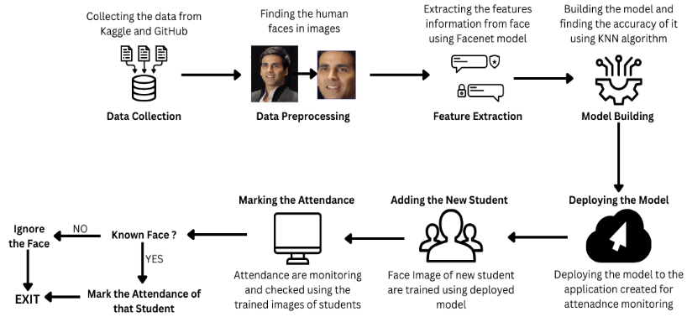
Proposed system

Slide 9

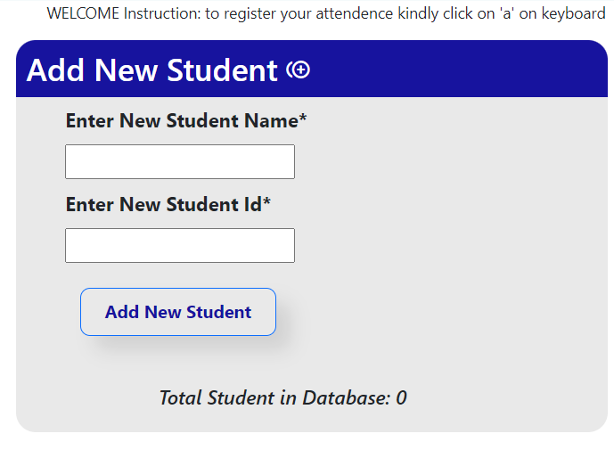
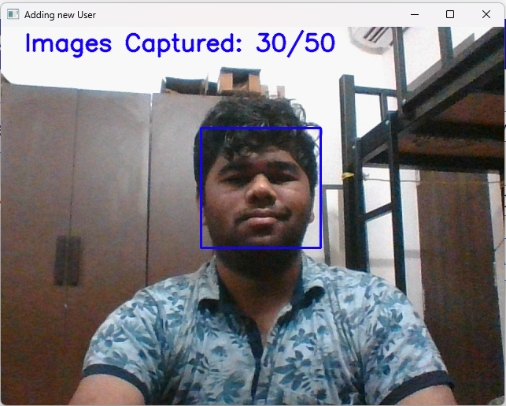
Results

Slide 10
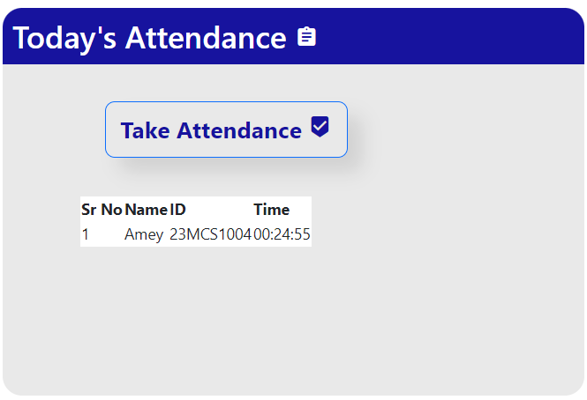
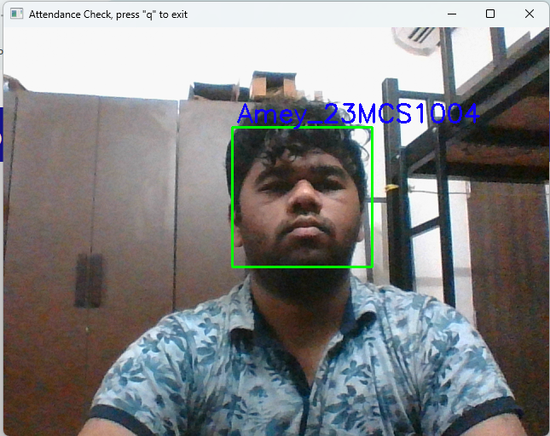
Results

Slide 11
Conclusion
Developed a new approach to enhancing facial recognition systems
Integrated various techniques including FaceNet, KNN, and Haar Cascade
Achieved an accuracy rate of 97.76%
Demonstrated progress in creating highly functional facial recognition systems
Potential for wide applicability in diverse situations

Slide 12
THANK YOU

